Slide 1
Snake Game: A Computer Vision Project
By:
Vaibhav Pratap Singh (2K21/IT/189)
Vaibhav Agrawal (2K21/IT/187)
Akramah Faizi (2K21/IT/180)

Slide 2
What is a snake game?
The Snake game is a classic arcade game where the player controls a snake that moves around a bounded area, such as a grid or a screen. The objective of the game is to eat food pellets placed randomly on the playing field while avoiding collisions with the snake's own body.
Initial Setup: The game begins with a snake (usually consisting of a single segment) and one or more food pellets placed randomly on the screen.
Snake Movement: The snake moves continuously in a particular direction (e.g., up, down, left, or right). The player can control the direction of the snake's movement using arrow keys.
Eating Food: When the snake's head comes into contact with a food pellet, the pellet is consumed, and the snake grows longer by one segment. New food pellets are then randomly placed on the screen.
Snake Growth: As the snake consumes more food pellets, it grows longer, making it more challenging to navigate the playing field without colliding with itself.
Collision Detection: The game detects collisions between the snake's head and the snake's own body. If the snake collides itself, the game ends.
Scoring: The player earns points for each food pellet consumed. The score typically increases with each pellet eaten.
Game Over: The game ends when the snake collides with itself. At this point, the player's final score is displayed, and they may have the option to restart the game.

Slide 3
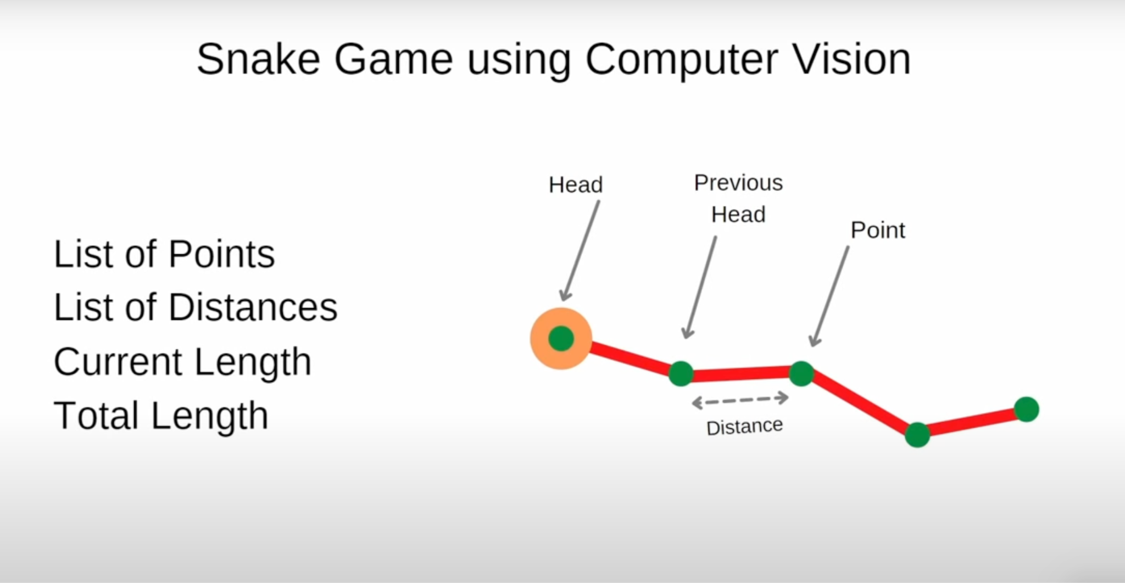

Slide 4
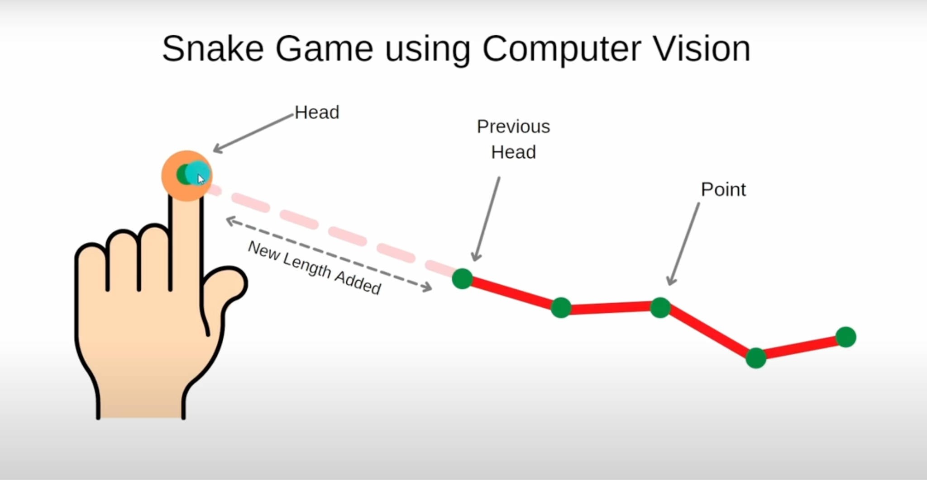

Slide 5
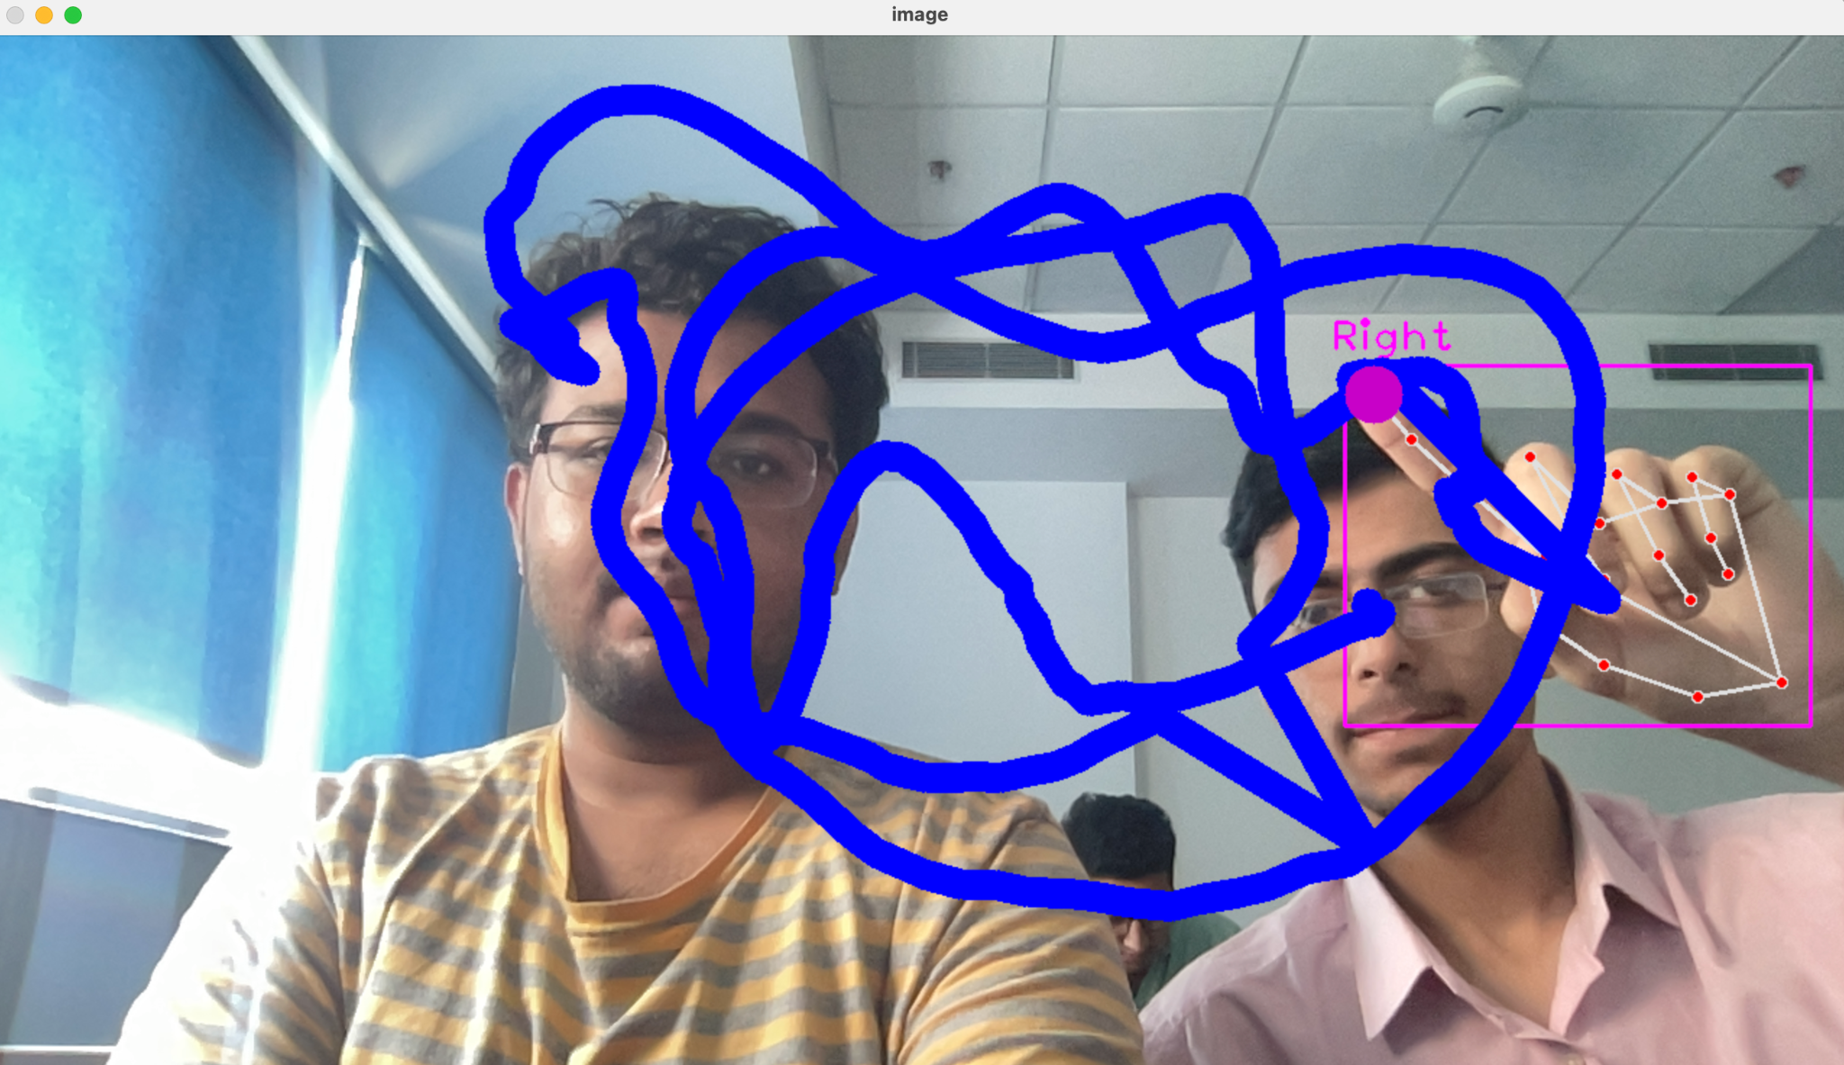

Slide 6
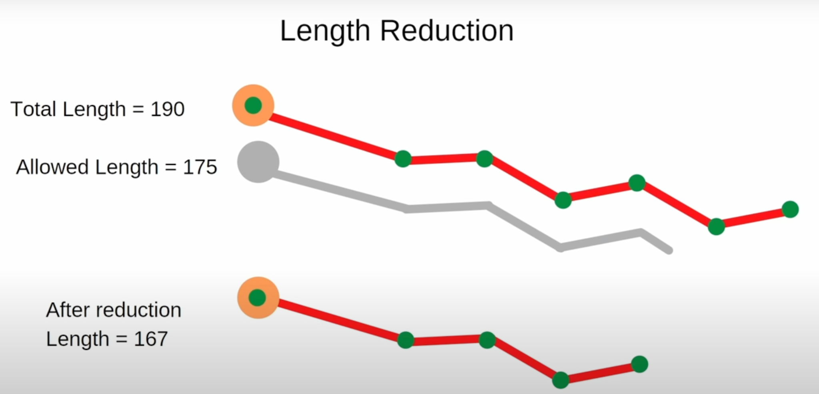

Slide 7
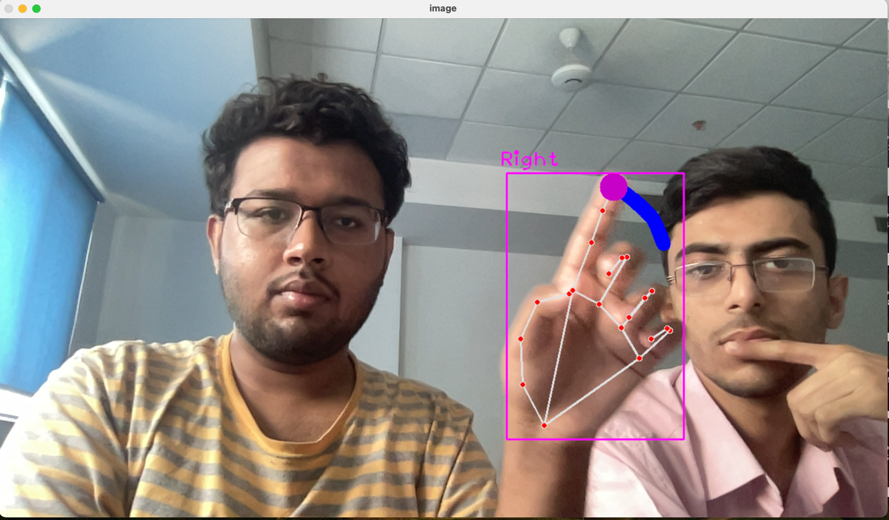
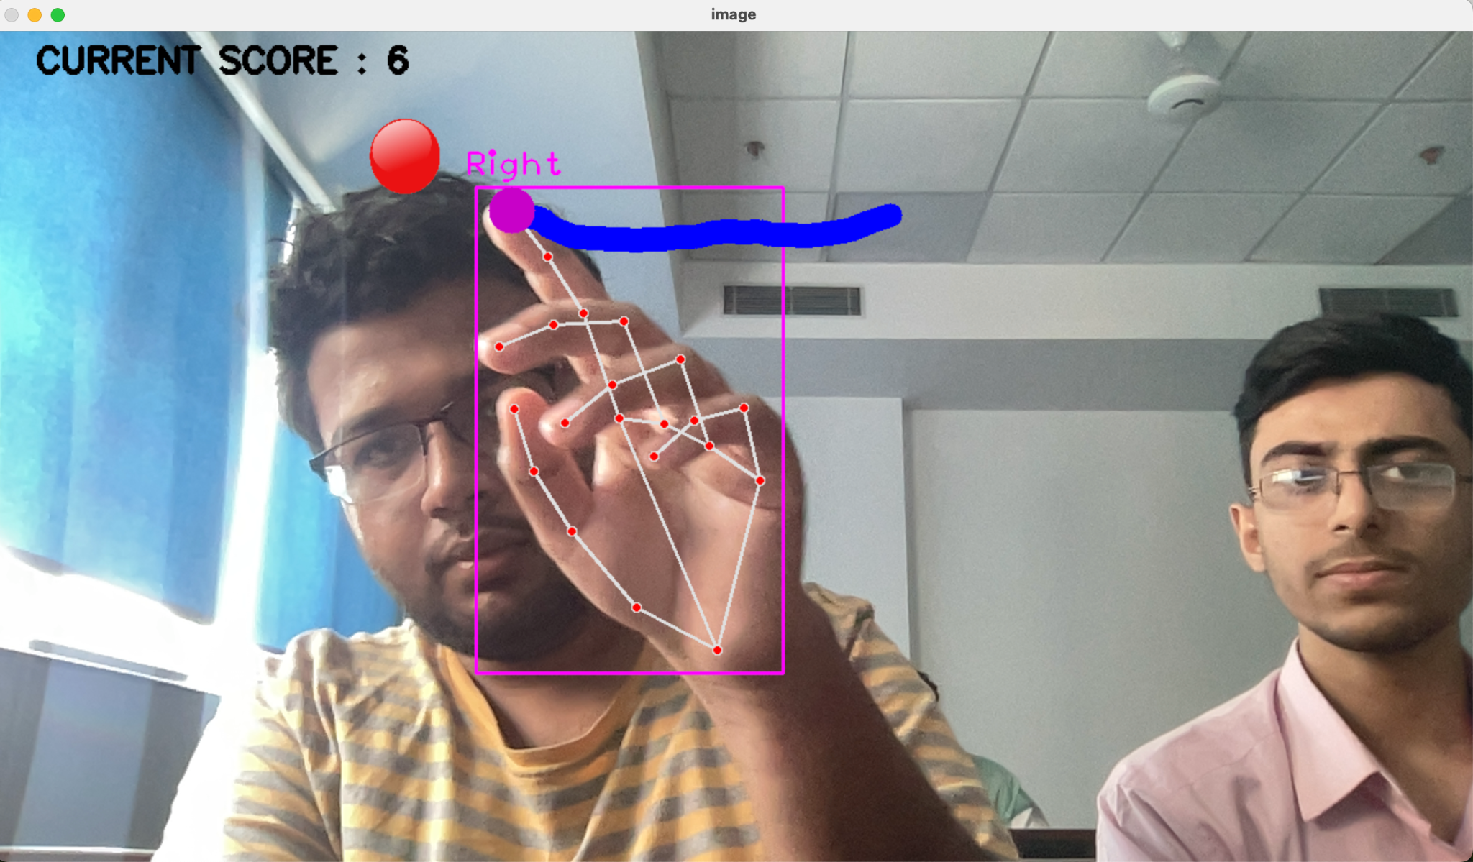

Slide 8
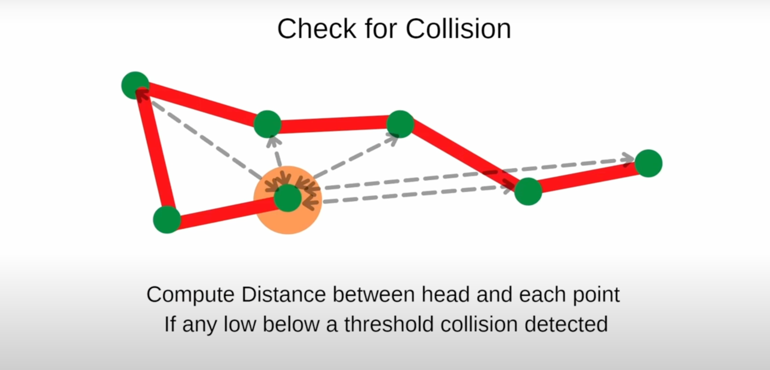

Slide 9
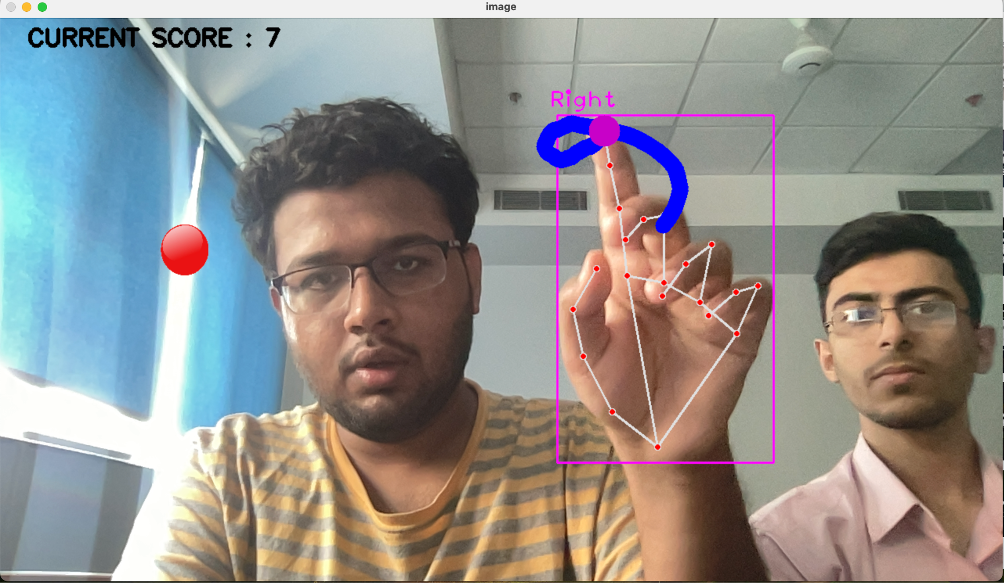
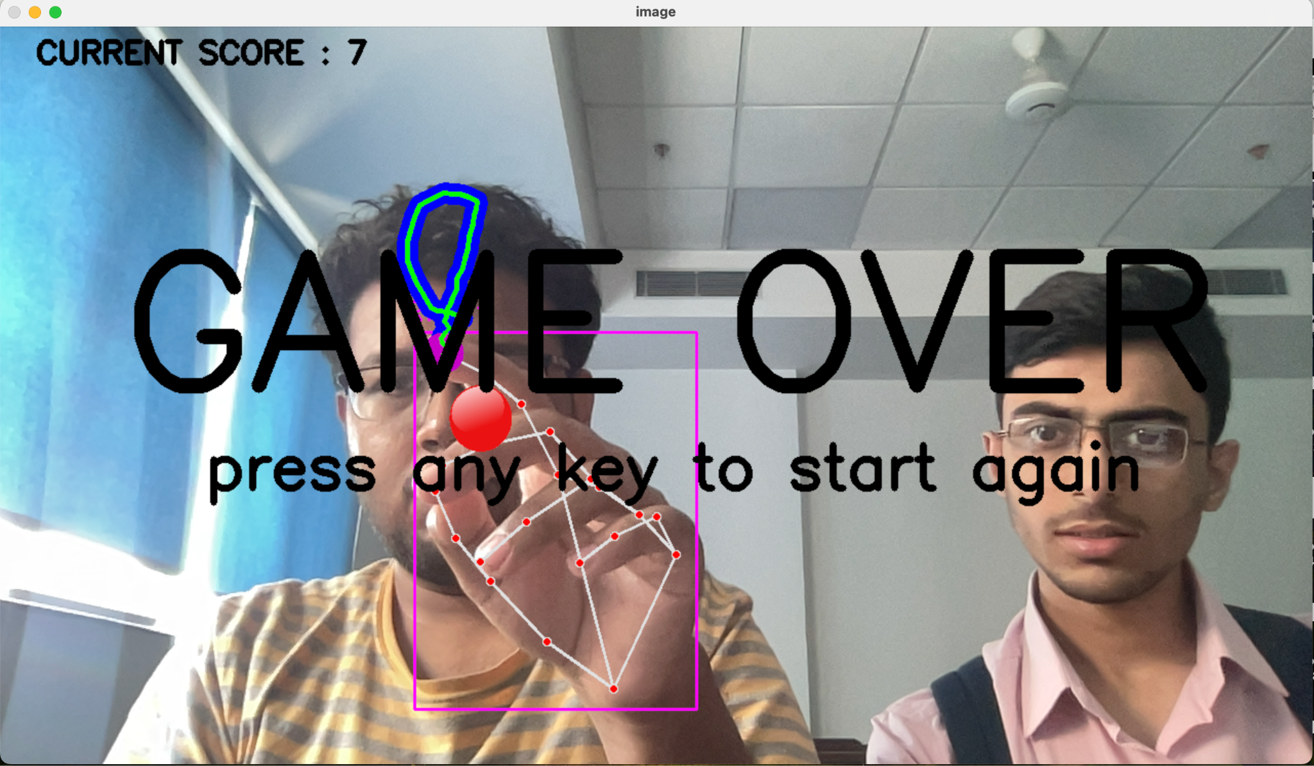

Slide 10
LIBRARIES USED

Slide 11
Basic Libraries
math: Python's math module offers mathematical functions and constants for basic arithmetic, trigonometry, logarithms, and more.For eg, We have used this function for computing distance between points using hypot function.
random: The random module provides functions for generating random numbers and making random selections, essential for tasks like simulations, games, and statistical analysis.This randint function was used to generate the random location of the food.
numpy: NumPy is a powerful library for numerical computing, offering multidimensional arrays and a range of mathematical functions, widely used in scientific computing, data analysis, and machine learning.For eg, Here, NumPy is used to create an array of points (pts) to draw the snake's body using cv.polylines().

Slide 12
OpenCV(cv2)
OpenCV (Open Source Computer Vision Library) is an open-source computer vision and machine learning software library. It was originally developed by Intel in 1999 and later maintained by Willow Garage and Itseez
It is widely used in various fields such as robotics, augmented reality, face recognition, object detection, and more.
It is compatible with multiple operating systems including Windows, Linux, macOS, Android, and iOS.
Originally written in C and C++, OpenCV also provides bindings for popular programming languages like Python, Java, and MATLAB, making it accessible to a wide range of developers.
It has a large and active community of developers and researchers contributing to its development and maintenance. It also provides extensive documentation, tutorials, and examples to help users get started with their projects.

Slide 13
MediaPipe
MediaPipe is an open-source library developed by Google that offers solutions for building pipelines to process perceptual data, such as images and video streams. It provides ready-to-use machine learning (ML) models and components for various tasks in computer vision, multimedia, and sensor processing.
MediaPipe follows a modular design approach, where developers can build complex pipelines by connecting reusable components called "calculators." These calculators process and transform input data through a series of stages, enabling tasks like object detection, hand tracking, face detection, pose estimation, and more.
MediaPipe comes with pre-trained machine learning models for various tasks, making it easier for developers to incorporate advanced computer vision capabilities into their applications without having to train models from scratch. These models are optimized for real-time performance and efficiency.

Slide 14
CVZone
CVZone is a Python library built on top of OpenCV and Mediapipe that provides additional functionalities and utilities for computer vision and image processing tasks. It aims to simplify common tasks and streamline the development process by offering ready-to-use components and tools.
It extends the functionality of OpenCV by providing additional utilities and helper functions for various tasks such as image processing, feature detection, object tracking, and more.
It abstracts away some of the complexities of working with OpenCV by providing higher-level abstractions and APIs for common tasks. This simplifies the code and makes it easier for developers to understand and maintain their computer vision applications.
It may integrate with other popular libraries and frameworks in the Python ecosystem, such as NumPy, SciPy, and scikit-image. This integration allows developers to leverage the capabilities of these libraries seamlessly within their CVZone-based applications.

Slide 15
Handtracking module
The HandTrackingModule of cvzone is a Python module designed for hand tracking and gesture recognition tasks using computer vision techniques. Here's a breakdown of some of the concepts involved in hand tracking:
Coordinate Systems: Hand tracking involves working with pixel coordinates in the image frame and converting them to real-world coordinates or relative coordinates within the frame. Understanding the coordinate systems and transformations between them (e.g., from image coordinates to camera coordinates) is essential for accurate hand localization and tracking.
Feature Detection: Hand tracking algorithms detect key features of the hand, such as fingertips, palm center, and finger joints. This often involves analyzing image gradients, contours, and shape descriptors to identify relevant hand structures accurately.

Slide 16
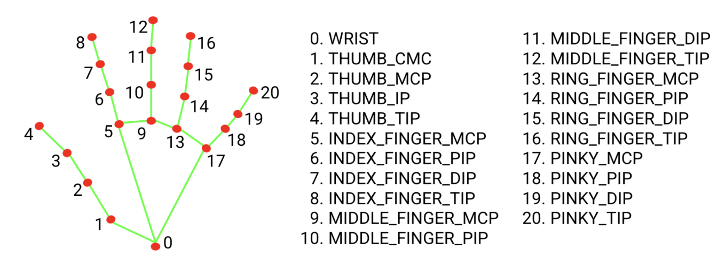
Geometry and Trigonometry: Calculations related to hand geometry and trigonometry are common in hand tracking. For example, determining distances between landmarks, estimating angles between fingers, and detecting hand poses based on geometric relationships require knowledge of trigonometric functions and geometric properties.
Linear Algebra: Hand tracking may involve linear algebra operations such as matrix transformations, vector operations, and solving linear equations. Techniques like matrix multiplication, vector normalization, and eigenvalue decomposition may be used to process hand tracking data efficiently.

Slide 17
THANK YOU

